Slide 1
Exercise 9.2 – Data Visualization
Patrick Weatherford – DSC 500
Introduction to Data Science

Slide 2
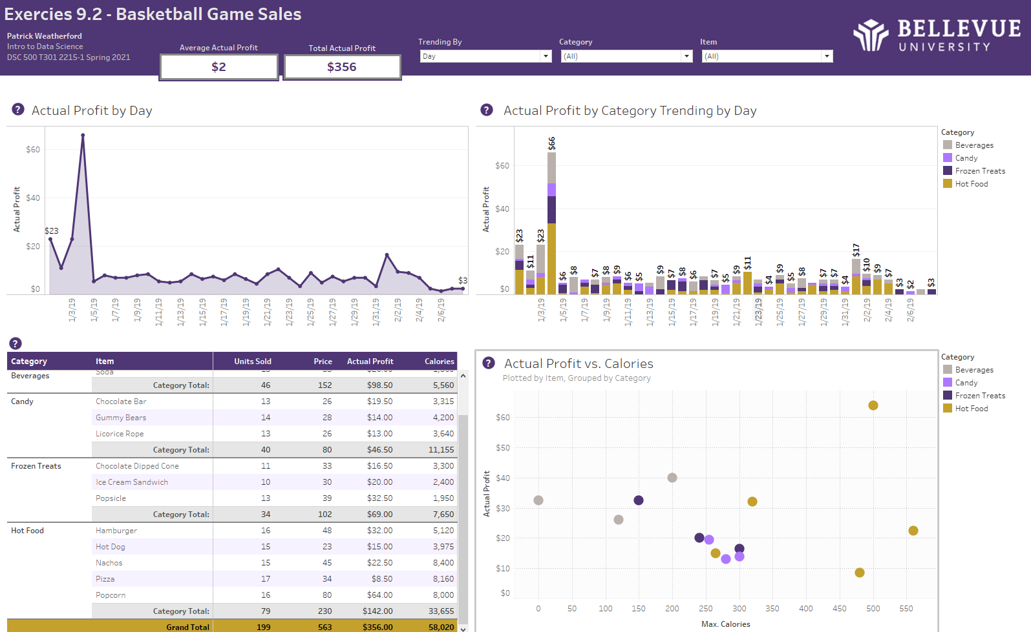

Slide 3
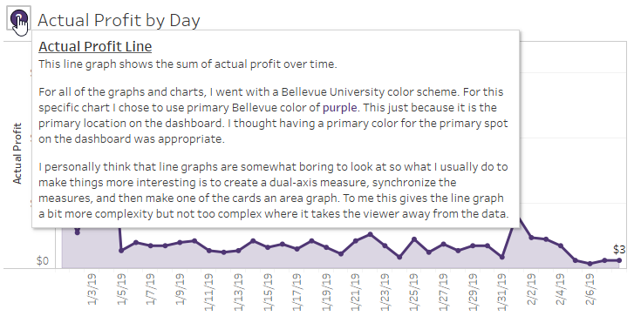
Actual Profit by Day

Slide 4
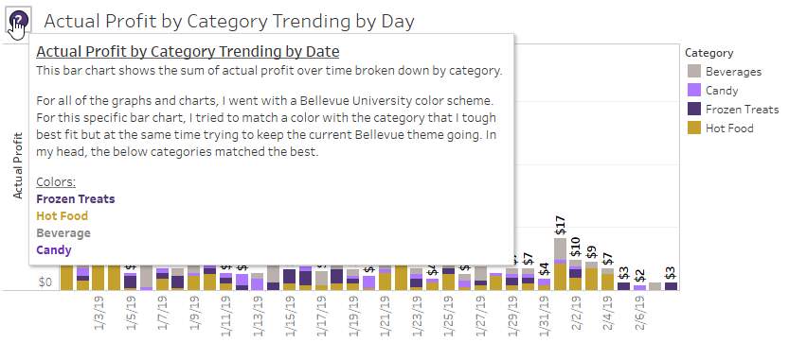
Actual Profit by Category Trending by Day

Slide 5
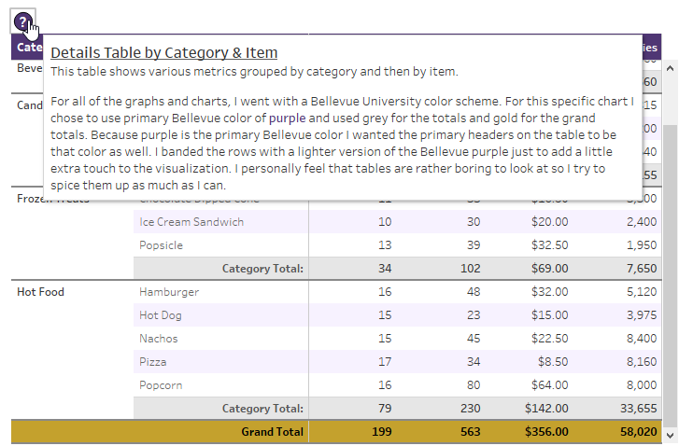
Details Table by Category/Item

Slide 6
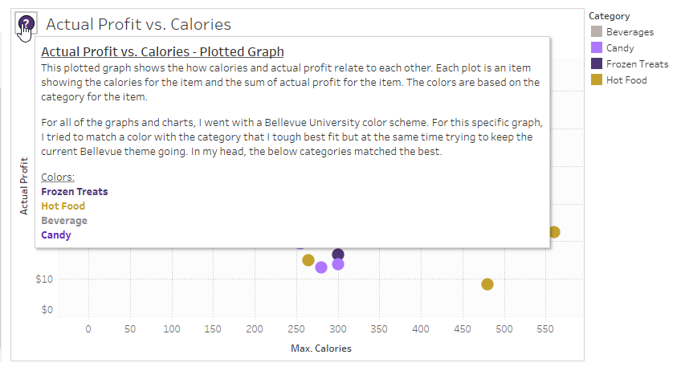
Actual Profit vs Calories – Plotted Graph

Slide 7
Attached Tableau File

